Slide 1
Mines, Minerals, and Minecraft
Dr. Charles “Chuck” Bell
Lesson 7: 13 March 2019

Slide 2
Agenda
Bible Study: 10-15 minutes
The Raspberry Pi: 5-10 minutes
Hacking Minecraft with Python: 30-45 minutes
Lab Time: Games in Minecraft

Slide 3
Bible Study
How coins were made in Biblical times

Slide 4
How Coins Were Made
Coins were made from gold, silver and bronze.
The metals would be heated until molten and then poured into molds to create blank coin flans.
The two sides of the mold would be put together.
Molten metal is poured in these grooves on the top and the metal would flow by gravity to the bottom.

Slide 5
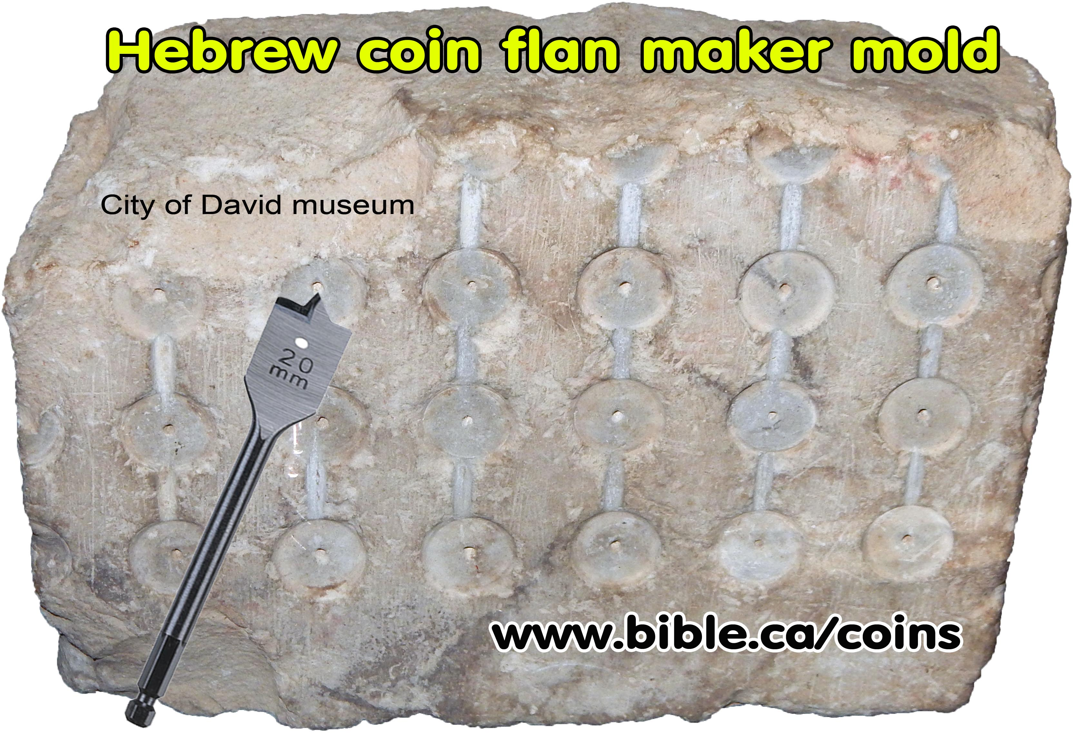
Flan
Notice the grooves at the top of each half of the mold.
Coin molds were made of soft chalkstone.
Hebrew, Judean Coin Molds
Coin molds are rare and very few have been found in Israel. This one is from Khirbet Rafi, located 33 km SE of Jerusalem near Lachish.

Slide 6
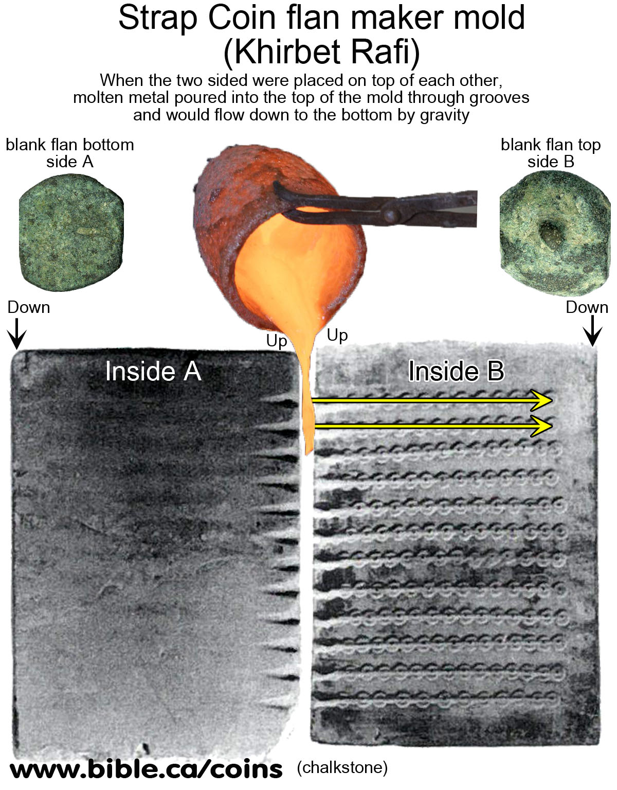
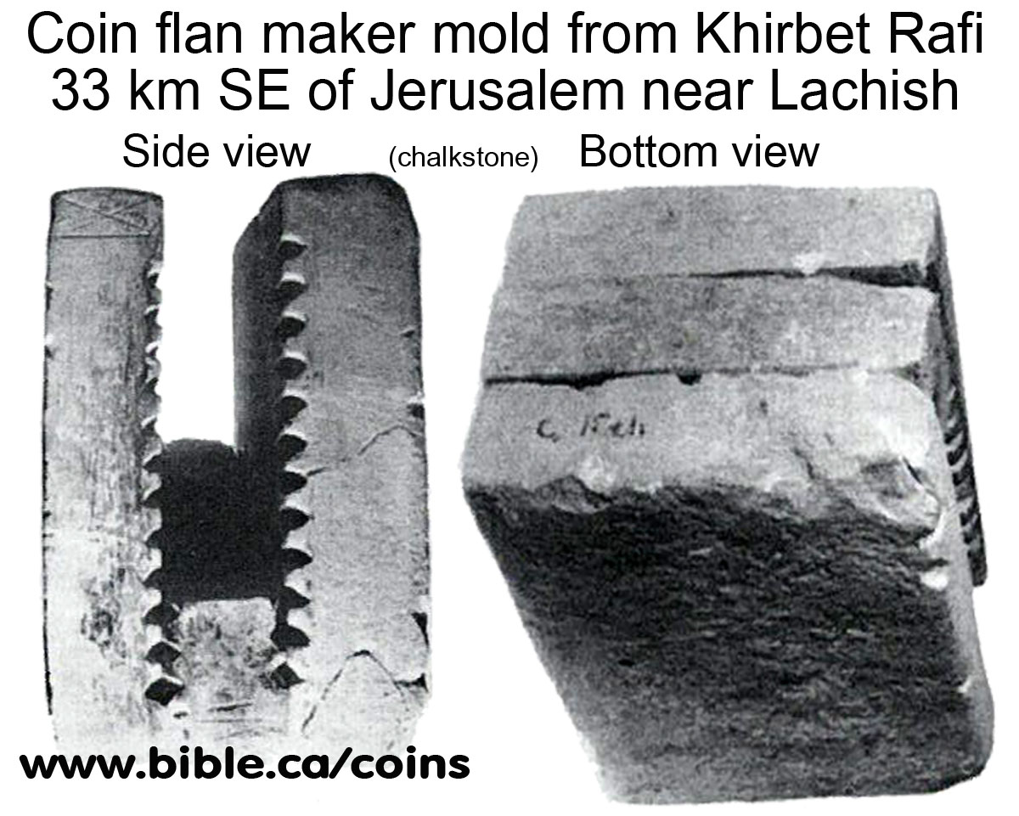
Flan

Slide 7
How Coins Were Made
Once the metal cooled they removed the strips of coin flans.
Flan blank dimples: A rotary tool very much like today's modern flat wood drill bit, was used to drill out the mold so that the coins could be created. The result was little dimples on the flan blanks.

Slide 8
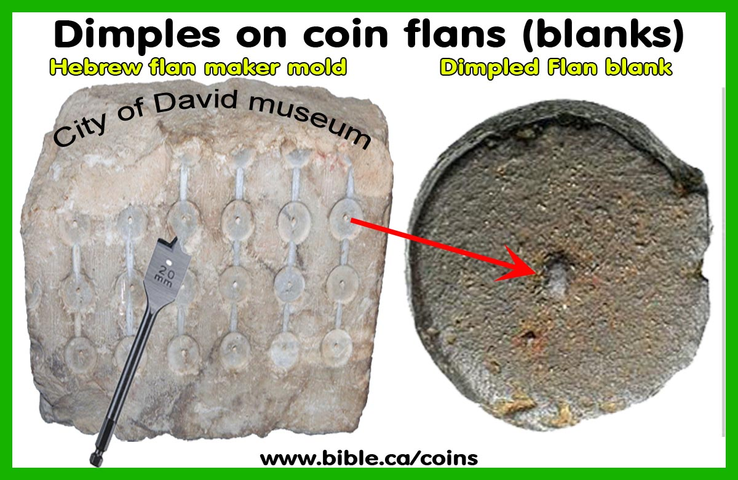
Flan

Slide 9
How Coins Were Made
Center punch mark holes
Coins were sometimes planed with a rotary tool that looks much like a flat wood bit.
It was used to smooth one or both sides of the flan to remove dross, little ridges and give the flan a bit of a polish.
The result was a little hole in the coin where the center tang of the polishing drill anchored itself into the coin.
Contrary to first appearance, these "center punch marks" are not made by center punching the coin after they were in circulation.
This center hole was on the blank flan before it was hammered in the dies.
These holes are common in Seleucid coins, do not detract from their value and are not considered defects.

Slide 10
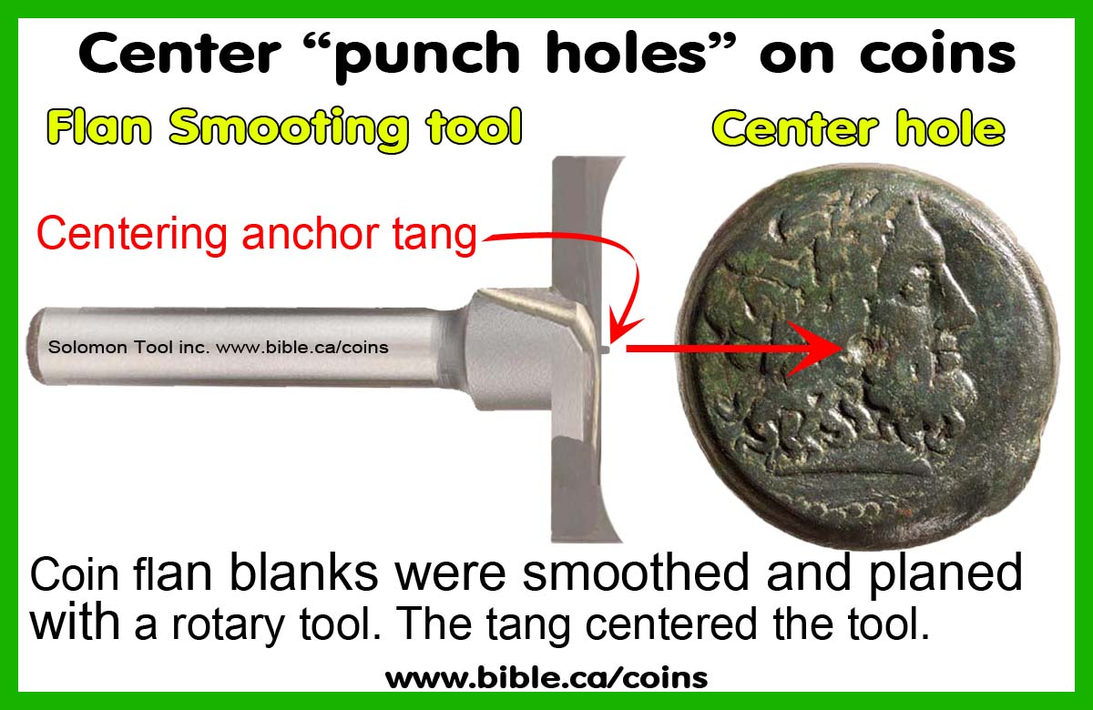
Center Hole

Slide 11
How Coins Were Made
There were a set of two dies made from iron and the blank coin flan would be placed in the bottom die, which was on a large stable rock.
They would place the top die on and strike it with a large iron mallet.
The coins would then be cut apart and trimmed of excess metal.

Slide 12
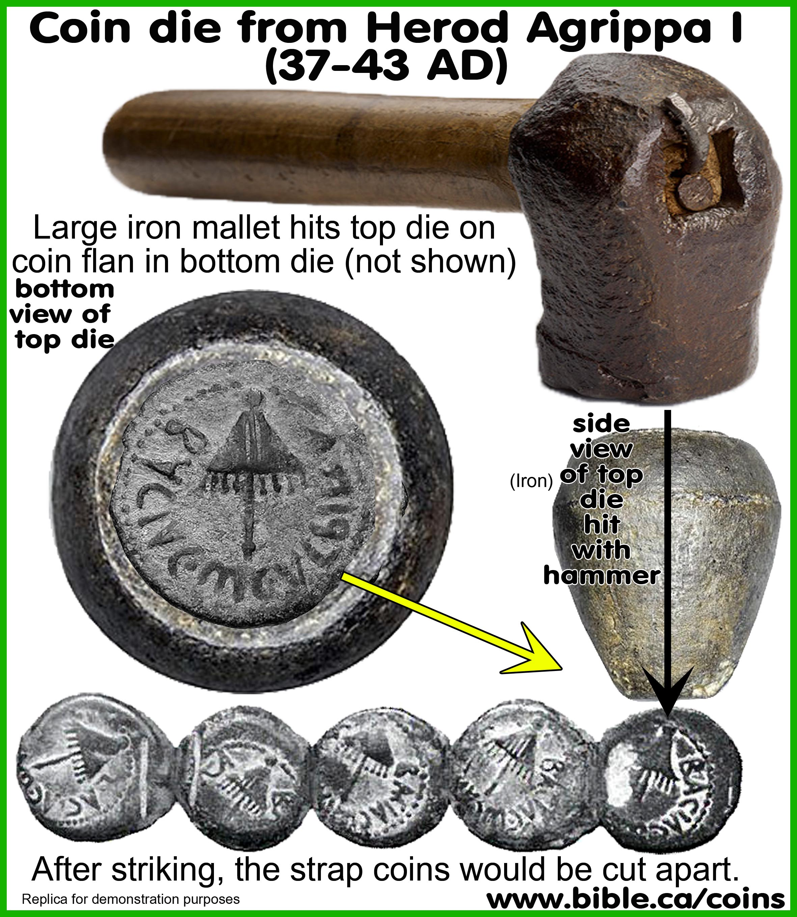
Coin Die

Slide 13
The Raspberry Pi – Operating Systems

Slide 14
Operating Systems
The base or default operating system for the Raspberry Pi is Raspbian.
We use this on our machines in class.
However, there are other alternatives that you can install instead of Raspbian; each with certain advantages or uses.

Slide 15
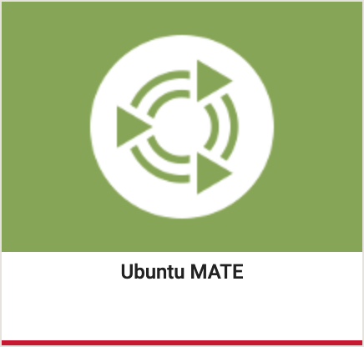

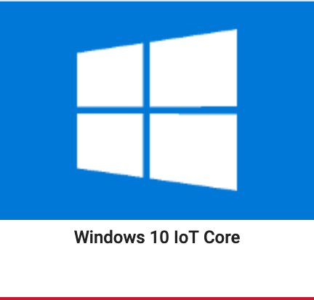
Alternative Operating Systems
Ubuntu MATE: a trimmed down version of the popular Ubuntu operating system.
Snappy Ubuntu Core: an IOT version of Ubuntu for running embedded applications.
Windows 10 IOT Core: a scaled down IOT version of Windows 10
See my book on the topic.

Slide 16


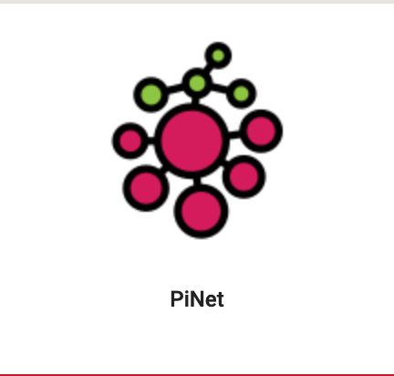
Alternative Operating Systems
OSMC: free and open source media center built for the people, by the people.
LibreELEC: lightweight ‘Just enough OS’ Linux distribution purpose-built for Kodi on current and popular media center hardware.
PiNet: Centralized user accounts and file storage system for a Raspberry Pi classroom.

Slide 17
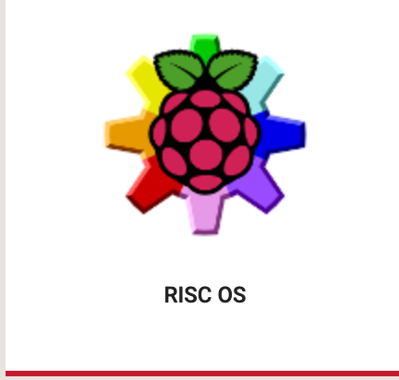
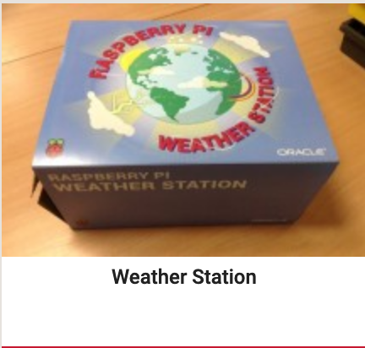

Alternative Operating Systems
RISC OS: designed specifically for the ARM processor. It is fast, compact and efficient. It is developed and tested by a loyal community of developers and users.
Weather Station: pre-built OS with support to build a weather station.
IchigoJam: Raspberry Pi Edition of the software of the Kids PC "IchigoJam” (a hardware learning platform for kids).

Slide 18
Alternative Operating Systems
You can find links to downloading each of these operating systems at:
https://www.raspberrypi.org/downloads/
If you want try any of them out, just create a new SD Card with the OS and boot the one you want.

Slide 19
Hacking Minecraft with Python
Let’s build some games!

Slide 20
The Lavatrap Game
You’re going to create a mini-game.
A lava pit will instantly appear and Steve will be put at the center of it; soon, the block he’s standing on will disappear so he will have to move, but hang on: all the blocks keep disappearing!
Your task is to replace the missing blocks with any other block.
You win when all lava blocks are replaced.
You loose if you fall into the lava.

Slide 21
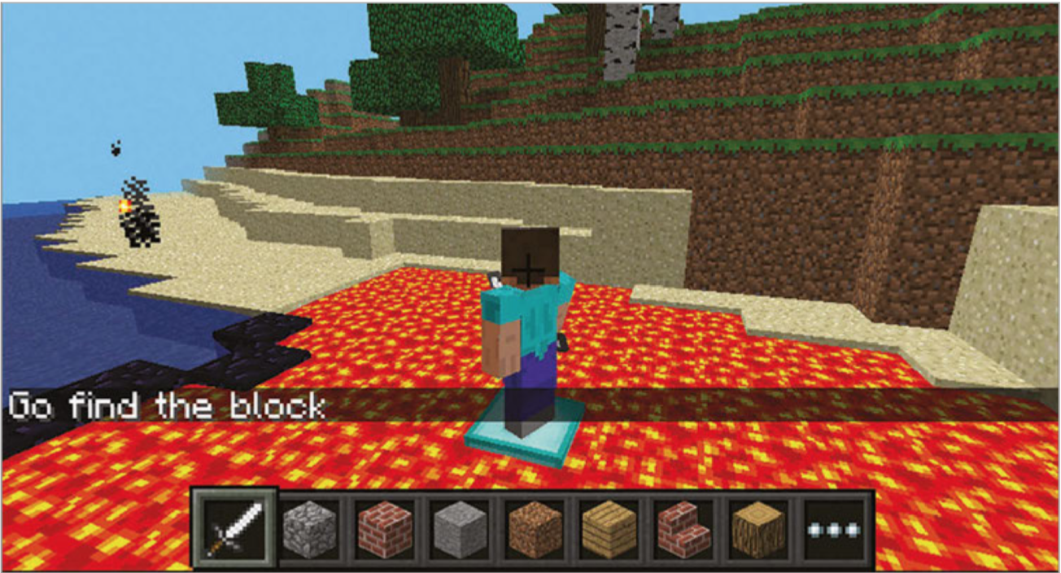
The Lavatrap Game

Slide 22
The Code
Introduction
import mcpi.minecraft as minecraft
import mcpi.block as block
from time import sleep
mc = minecraft.Minecraft.create() mc.postToChat("Welcome to the Lava Trap")

Slide 23
The Code
Setup the game board
sleep(3)
pos = mc.player.getTilePos()
mc.setBlocks(pos.x - 5, pos.y - 2, pos.z - 5,
pos.x + 5, pos.y - 2, pos.z + 5,
block.STONE.id)
mc.setBlocks(pos.x - 5, pos.y - 1, pos.z - 5,
pos.x + 5, pos.y - 1, pos.z + 5,
block.LAVA.id)

Slide 24
The Code
Setup the game
mc.setBlock(pos.x, pos.y - 1, pos.z, block.DIAMOND_BLOCK.id)
mc.postToChat("Get Ready")
mc.postToChat("Blocks under you will keep "
"disappearing")
sleep(3)
mc.postToChat("Go")

Slide 25
The Code
The game control loop:
gameover = False
while gameover == False:
p = mc.player.getTilePos()mc.setBlock(p.x,
p.y - 1, p.z, block.OBSIDIAN.id)
sleep(2)
mc.setBlock(p.x, p.y - 1, p.z, block.AIR.id)
sleep(0.5)
if p.y != pos.y:
gameover = True
mc.postToChat("Game over.")

Slide 26
The Lavatrap Game
Now, you try playing the game for a few minutes.
Connect to the Internet and update the git repo:
Open a terminal
cd Documents/Mines-Minerals-and-Minecraft
git pull
Open and run the code named lavatrap.py.
Find a nice, level area to start the game.
Warning: it’s not easy!

Slide 27
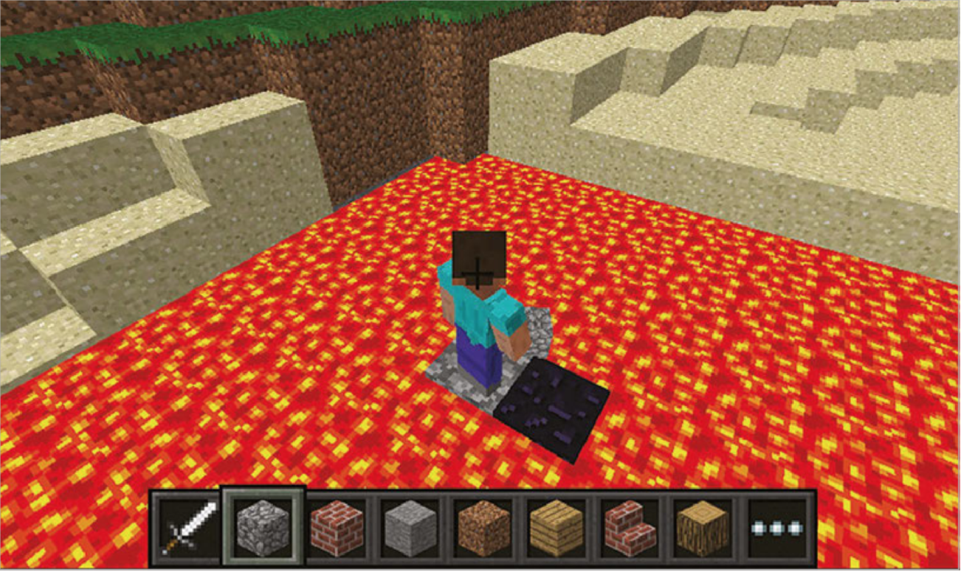
The Lavatrap Game

Slide 28
Next Steps
Make the game harder.
Make the area larger.
Add two layers of lava blocks.
Make a better game arena, perhaps building a stadium or walls around it so Steve cannot get out.
Add points to the game; each time Steve doesn’t fall in, he gets a point.
Change the game so it starts easy but gets harder the longer you play.
Randomly add blocks
Randomly re-add blocks you cleared.

Slide 29
LAB TIME
Use the remainder of class to explore The Lavatrap Game.
You can leave when you’re finished.
DO NOT DISTURB the other classes!
REMEMBER TO SHUTDOWN YOUR RASPBERRY PI
DO NOT POWER IT OFF UNTIL YOU SHUTDOWN

Slide 30
Questions or comments?

